Slide 1
TOPIC
FLOOD MONITORING & EARLY WARNING

Slide 2
BATCH MEMBERS
NAME
DHIVAGAR
AKASH
KIRUBAKARAN
GOPINATH
KARTHIKEYAN

Slide 3
INTRODUCTION
To develop a real-time flood monitoring and early warning system.
One of advantage of ultrasonic sensing.
Work falls under the utilization of the Arduino, ultrasonic sensors, GSM module, web-monitoring
The paper envisions helping flood-prone area.

Slide 4
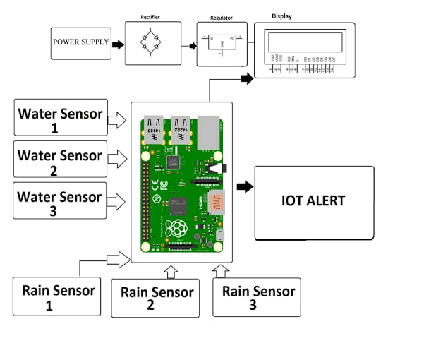
BLOCK DIAGRAM

Slide 5
WORKING PRINCIPLE
The Ultrasonic sensor works on the principle of SONAR.
It is designed to measure the distance using ultrasonic wave.
To determine the distance of an object from the sensor.
For value Arduino decides width for opening of gates of dam.

